Slide 1
The Plan for Tomorrow
Compile-Time Extension Points for C++ Libraries and Applications
JeanHeyd Meneide
April 25th, 2019
New York C++ Meetup, MongoDB, New York, NY

Slide 2
Extension Goals: Adding Functionality…
beyond what was initially considered by application / library authors
Callback functions with void* userdata in C libraries
to perform some semantically-expected task for types outside author’s purview
std::swap
to endow a class with a specific, compatible interface
virtual protected functions in iostreams

Slide 3
Well-Known Extension Methods
A brief overview of compile-time and runtime hybrid extension technology

Slide 4
Well-Known: Virtual methods
No surprises here: create base class and stuff it with virtual methods
struct animal { virtual std::string sound () const = 0; };
struct dog : public animal { virtual std::string sound () const override { return “woof”; } };

Slide 5
Well-Known: Virtual methods usage
Used extensively up to ~2008, less so now in place to static polymorphism
Many game engines: Ogre, Irrlicht, Doom, etc…
Qt: QObject and the entire class tree
Clang: ASTMatchers and extension points
C++ standard library: iostream customization points
One too many C++ university classes

Slide 6
Standard Library Case Study: iostreams
C++ streambufs/streams – 3 kinds different hooks
fixed interface, calls into…
protected virtual inherited members, which utilize…
traits type (char_traits), facets, and more inside function calls
How it works:
Define your own stream type
derive from standard base(s), using virtual bases where needed
overload protected virtual functions (overflow, xsputn, underflow, unflow, …)

Slide 7
Streams: good idea, poor overall design
Saves on some degree of template boilerplate
Means you can compile and fix an std::ostream& API boundary
But you cannot accept “wide” (ugh) streams
Issue of quality of specification versus implementation
Standard library implementers always complain about the specification
Too many things a user can customize
Extreme mixing of layers: 3 kinds!

Slide 8
Benefits: Virtual methods
Can work with super class (base class) at compile-time
calls the right method at runtime
no need to bookkeep function pointers and similar
Heavily optimized by compiler writers to de-virtualize simple cases
E.g.: current-gen non-user-specialized iostreams, C++ XAML, and more

Slide 9
Drawbacks: Virtual methods
ABI-brittle
adding a function to class might append to virtual table, but may insert in middle of derived class’s virtual table
difficult to detect mismatches
Runtime efficiency
Does “X” need to be virtual? Must decision be delayed to runtime?
Implementation-controlled Virtual Tables / Slicing Problem
Base classes must be handled as pointers / references or risk slicing

Slide 10
Callbacks with Userdata
Function which takes a strongly-typed function pointer and a void* userdata
Staple of C APIs everywhere, including some C standard library functions
Highly flexible
Used to let (application) developer do things beyond what was envisioned
e.g., serialize data into to a std::vector instead of a FILE*
typedef int (*lua_Writer)(lua_State*, const void*, size_t, void*);
int lua_dump(lua_State* L, lua_Writer writer, void* userdata, int strip_symbols);

Slide 11
Easy to wrap in C++
Typical C call, wrapped in C++
template <typename Callback>
int dump_handler(lua_State* L, const void* data, size_t data_size, void* userdata) {
Callback& callback = *static_cast<Callback*>(userdata); return callback(L, data, data_size);
}
template <typename Callback>
void dump_with(lua_State* L, Callback&& callback, bool strip_symbols = true) {
lua_Writer writer = &dump_handler<std::remove_cvref_t<Callback>>;
void* userdata = static_cast<void*>(std::addressof(callback)); lua_dump(L, writer, userdata, static_cast<int>(strip_symbols));
}

Slide 12
Easy to wrap in C++: No Templates
Fix the interface to save on template duplication for every callable…
using dump_function = std::function<lua_State*, const void*, data_size_t>;
int dump_handler(lua_State* L, const void* data, size_t data_size, void* userdata) {
dump_function& callback = *static_cast<dump_function*>(userdata); return callback(L, data, data_size);
}
void dump_with(lua_State* L, dump_function callback, bool strip_symbols = true) {
lua_Writer writer = &dump_handler<std::remove_cvref_t<Callback>>;
void* userdata = static_cast<void*>(std::addressof(callback)); lua_dump(L, writer, userdata, strip_symbols);
}

Slide 13
Easy to wrap in C++: No Templates
std::function is expensive
Higher efficiency, low cost for (maybe) C++20: std::function_ref
using dump_function = std::function_ref<lua_State*, const void*, data_size_t>;
int dump_handler(lua_State* L, const void* data, size_t data_size, void* userdata) {
dump_function& callback = *static_cast<dump_function*>(userdata); return callback(L, data, data_size);
}
void dump_with(lua_State* L, dump_function callback, bool strip_symbols = true) {
lua_Writer writer = &dump_handler<std::remove_cvref_t<Callback>>;
void* userdata = static_cast<void*>(std::addressof(callback)); lua_dump(L, writer, userdata, strip_symbols);
}

Slide 14
Easy…?
Inline and synchronous execution:
No need for storage
No need to manage lifetime
Non-inline execution:
Callling it later (events in Qt, libev, etc.)? Need storage.
Multithreading? Need storage.
Storage means lifetime…

Slide 15
Well-Known: Callbacks with userdata usage
Literally every C library, ever…
Lua, libclang,
libpng, libjpeg
jansson, libev, freetype
Win32: everywhere
C Standard Library: qsort

Slide 16
Benefits: Callback with userdata
Space and time efficient
especially if callback never needs to be stored
function pointers are cheap
ABI-hardy
difficult to break ABI unless the actual callback interface changes
user can place extra data into void* for their needs at no cost to library

Slide 17
Drawbacks: Callback with userdata
Exception/early exit issues
if stored, is the callback called when an exception is tossed?
In-lining optimizations for compiled code becomes restricted
qsort(…) vs. std::sort(…)
link time optimizations helps here
Lifetime issues, when
storing the callback to call “at a later date”
multithreading concerns

Slide 18
Compile-Time Extension
Picking and choosing work to execute using compile time choices

Slide 19
Extension Methodologies
Compiler-Assisted
(Partial) Class Template Specializations
“Koenig”/Argument-Dependent Lookup (ADL)
Static friend functions
Template functions + Overloading
Author Mandated
Traits/Policy/Agent templates

Slide 20
Class Templates + Specialization
Uses a class template
User then (partially) specializes a class for this template
Case studies: sol2, std::hash
Base template, user specialized templates
Using this class:
struct two_things { int a; bool b; };

Slide 21
sol2 and std::hash
case studies in class template specializations

Slide 22
Sol2: sol::stack::getter<T, C>
// sol.hpp
namespace sol { namespaces stack { template <typename T, typename C = void> struct getter { static T get(lua_State*, int, record&) { /* default implementation here */ } }; }} // namespace sol::stack

Slide 23
sol2: full class template specialization
// user.cpp
namespace sol { namespace stack { template <> struct getter<two_things> { static two_things get(lua_State*, int, record&) { /* user code here */ } }; }} // namespace sol::stack

Slide 24
Drawback I: specialization collisions
Fail to separate base implementation versus user implementation
All user customization points must occupy the same finite code space
All explicit and specializations must not collide (mutual exclusion principle)
Bad design in sol2 led to a few annoying collisions/fighting with user specializations
💥
✔️
✔️

Slide 25
Drawback I: SFINAE power
Extra template argument is needed on every extension point for SFINAE traits to be applied
SFINAE is messy
decltype() and is_detected SFINAE slightly less ugly than std::enable_if_t
introduces mutual exclusion principle problems
template <typename T>
struct custom_point<T, /* SFINAE here */> {
/* … */
};

Slide 26
Drawback II: specialization collisions
namespace sol { namespace stack { template <typename T>
struct getter<T, std::enable_if_t<std::is_integral_v<T>>> {
static T get(lua_State*, int, record&) {
/* implementation for integers */
}
}; } // namespace sol::stack

Slide 27
Drawback II: specialization collisions
namespace sol { namespace stack { template <>
struct getter<std::uint64_t> {
// ^ CLANG ERROR: ambiguous specialization
static std::uint64_t get(lua_State*, int, record&) {
/* implementation for integers */
}
}; } // namespace sol::stack

Slide 28
Drawback II: specialization collisions 💥
user.hpp
lib.hpp
template <typename T>
struct custom_point<T, std::enable_if_t<
has_begin_end_v<T>
>
>
{
/*… */
};
template <typename T>
struct custom_point<
my_vector<T>
>
{
/*… */
};
E R R O R

Slide 29
Drawback III: “arcane” knowledge 🧙
“The code isn’t working”
navigating the syntax and rules of template instantiations means glazed over looks and general confusion
when providing support, usually teach user about partial template specialization (or just give them an example)
Typical C++ users just want to write simple code
Classes (with or without static functions): ✔️
Functions (exported, inline, etc.): ✔️
Templates (rules of ODR, visibility of specialization at time of use, etc.): ❌

Slide 30
Drawback IV: visibility and defaults 👀
Is the class template specialization…
visible in all possible translation units where it may be used?
body dependent on macros that are not defined for the entire build (and its dependencies?)
Silent ODR violation that compiles, links and runs on all known compilers.
Problematic with all compile-time extension points where default is not a noisy error
📦 Specialization must be tightly packaged with class when used!

Slide 31
Drawback V: header bloat 🎈
Header contamination becomes a real problem to avoid ODR issues
entirety of sol2 comes along for the ride
produces longer build times
avoided with careful forward declaration of every required template and class
unfortunately, the standard itself does not provide forward-declaring headers
“modules will solve it” – unfortunately, little tangible evidence I can personally provide

Slide 32
std::hash<T>
Employs same struct specialization technique, but
is substantially simpler
has only one template argument
Well-used, so this simple case has become idiomatic
lack SFINAE makes it easier to teach
👨🏽‍🏫

Slide 33
std::hash<T>
namespace std {
template<> struct hash<two_things> { size_t operator()(const two_things& tt) const noexcept { auto h1(std::hash<int>{}(tt.a)); auto h2(std::hash<bool>{}(tt.b)); return my_hash_mix(h1, h2); } };
} // namespace std

Slide 34
std::hash<T>: benefits and drawbacks
Avoids arcane knowledge requirements by
being extraordinarily simple (write a function call operator)
not having a SFINAE parameter (avoids mutual exclusion)
Takes core specializations away from user
Pre-defined for enum types, integral types, etc.
Same visibility / header contamination issues
<functional> comes along for the ride 🐪, no forward declarations!

Slide 35
Frequent library vendor complaint
“They are opening up namespace std / my namespace 💢!”
paper to solve this presented in Rapperswil, Switzerland, 2018; p0665
allows a user to specialize outside classes in the namespace where the class is defined
Library vendors are hyper-sensitive to users opening up namespace std
people have done all sorts of interesting things in their code bases
required all large stdlib implementations to employ __ugly _Identifiers

Slide 36
(Template) Function Overloading
Step into the namespace of the function and add a similar name
does not depend on Name Lookup to “find” the function in associated namespaces
Usually explicitly blessed by library author as “possible”
old usage: viable way to customize std::swap
Case study
Boost.Serialization

Slide 37
Adding overloading to Boost.Serialization:
namespace boost { namespace serialization { template <class Archive> void serialize(Archive& ar, two_things& g, unsigned int version) { ar & tt.a; ar & tt.b; }
}} // namespace boost::serialization

Slide 38
Overloading: benefits and drawbacks
Direct additions to namespace separate extension point from target
benefit: if optional and not required, user can move customization function to independent header / implementation files
drawback: if required and not optional, then separation may not be desired and causes boilerplate
Same complaint from library vendors
opening up other namespaces 💢!
potential for name collisions and similar

Slide 39
Argument-Dependent Lookup 👾
Complicated set of rules
Rely on namespaces of arguments to add additional symbols to unqualified calls
primary intentional use: “generic” (templated) code to work with arbitrary types
primary unintentional use: operators to “just find the right call” for a == b
Case studies:
std::swap (the wrong way)
std::ranges / range-v3 (the right way)

Slide 40

Argument-Dependent Lookup: swap
swap(a, b) // invokes ADL because call name is unqualified
looks in the namespace of a and b, as well as the current scope’s namespace
likely a bug in generic algorithm if written outside std/a or b are not std
std::swap(a, b) // does not invoke ADL because call name is qualified
looks only in namespace std
likely a bug if used in a generic algorithm
Proper way:
using std::swap;
swap(a, b);

Slide 41
“Std Swap Two-Step”: verbosity is failure
“The problem with the Two-Step is that it forces users to type more to do the right thing. FAIL. Most damning, it requires users to either blindly memorize and regurgitate the Two-Step pattern, or worse: understand two-phase name lookup in templates.” – Eric Niebler, October 2014

Slide 42
Argument Dependent Lookup: range-v3
Create a callable function object which does the two-step with an internal detail namespace’s swap
Invokes ADL but prevents qualified call to ns::swap(a, b) being a bug
ADL is done “for you”: function object takes care of it

Slide 43
ADL Done Right™
namespace std { namespace detail {
template <Swappable A, Swappable B> // important!
void swap (A& a, B& b) { /* default implementation */ }
struct swap_func {
template <typename A, typename B>
void operator()(A& a, B& b) const noexcept {
using swap;
swap(a, b);
}; };
}} // namespace std::detail

Slide 44
ADL Done Right™
Create a constexpr object of the proper name sitting in the namespace
namespace std {
inline constexpr const auto swap = detail::swap_func{};
} // namespace std

Slide 45
ADL Done Right™: very simple
struct two_things {
int a;
bool b;
// just this
friend void swap (two_things& left, two_things& right);
};

Slide 46
Wait, is that a friend function?
Friend functions contain a few encapsulation benefits and help avoid name collisions
friend functions are the same as free functions, but:
hidden from qualified (my_namespace::func_name) calls due to being inside the class
findable by calls which invoke ADL

Slide 47
friend functions case study: abseil
Abseil uses this extensively for its customization points
in particular, AbslHashValue
struct Circle {
template <typename H>
friend H AbslHashValue(H h, const Circle& c) {
return H::combine(std::move(h), c.center_, c.radius_);
}
private:
std::pair<int, int> center_;
int radius_;
};

Slide 48
Benefits: ADL Done Right™
No Two-Step;
no subtle missed bugs in generic code
no inconsistency in “always qualify your calls”
Customization point writer gets there “first”
impose initial base-level concepts on the type
Allows user to define swap in namespace next to class / as friend function
just a function: easy to write and read

Slide 49
Drawback I: overloading catch-alls
Base implementation provided by author must SFINAE away or it will catch all calls and hard-error everything
must use decltype SFINAE, concept, or std::enable_if_t
Users may not properly constrain their overloads and write catch-alls
If users write a “generic” catch-all and do not properly constrain, the extension point is ruined for everyone

Slide 50
Drawback II: High Collisions
Does your function take perfect forwarding references?
prepare to cry: overloads in the same space may consume more calls than intended
worse: they might even unintentionally work but do the non-performant / wrong thing!
namespace std {
template <class Pointer, class Smart, class... Args>
auto out_ptr(Smart& s, Args&&... args) noexcept;
} // namespace std

Slide 51
But everyone will properly constrain!
And other lies I told myself after I read Eric’s blog post…

Slide 52

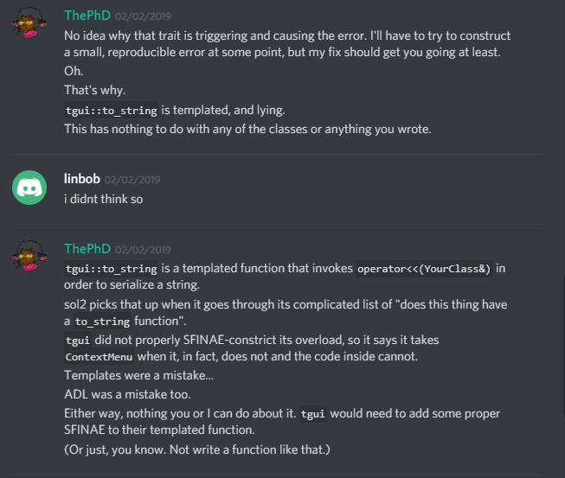
No.
They will not constrain it.
They will not use “only concrete types”.
The world is not full of only experts.

Slide 53
ADL Done… Right™?
“The Best Anyone Could Have Done With The Tools At Hand.”
range-v3 niebloids (begin, end, iter_move, dereference, etc.) contain no opt-out mechanism
does not prevent the ADL problem for unintentionally bad actors
makes it even more apparent when it does happen
cannot call “just the standard {begin/end/swap}” because it exists in an implementation-defined detail namespace now

Slide 54
ADL and Overloading: Bigger Problems
Functions can catch unintended calls
even if they are not templated
consider void* pointer conversions, derived -> base conversions, and more
Results in a huge problems for ADL and overloading
unintended “catches” of base types and other things a user would find surprising
Case study: sol3

Slide 55
sol3: ADL extension points
Associated extension points
sol::stack::get a value maps to sol_lua_get
sol::stack::check a type maps to sol_lua_check
sol::stack::push maps to sol_lua_push
int sol_lua_push(sol::types<two_things>, lua_State* L,
const two_things& things);
two_things sol_lua_get(sol::types<two_things>, lua_State* L,
int index, sol::stack::record& tracking)
template <typename Handler>
bool sol_lua_check(sol::types<two_things>, lua_State* L,
int index, Handler&& handler, sol::stack::record& tracking)

Slide 56
sol3: ADL extension point function call
template <typename T, typename... Args>
int push(lua_State* L, T&& t, Args&&... args) {
if constexpr (is_adl_sol_lua_push_v<T, Args...>) {
return sol_lua_push(...);
}
else {
/* hit default if constexpr internals */
}
}

Slide 57
sol3: trait implementation
template <typename... Args>
using adl_sol_lua_push_test_t = decltype(sol_lua_push(
static_cast<lua_State*>(nullptr), std::declval<Args>()...
));
template <typename... Args>
inline constexpr bool is_adl_sol_lua_push_v =
is_detected_v<adl_sol_lua_push_test_t, Args...>;

Slide 58
sol3: an example of old problems
Why type tags?
To solve conversion problems; for example, old conversion points
int sol_lua_push(lua_State* L, void* vp);
struct unrelated {};
int main (int, char*[]) {
sol::state lua{};
unrelated obj{};
unrelated* some_pointer = &obj;
// calls the above, not the default!
sol::stack::push(lua, some_pointer);
return 0;
}

Slide 59
Drawbacks: ADL and overloads
Must guard against conversions
can develop smarter and more complicated traits
prefer a type tag if the space of the ADL is unconstrained
Have templated functions that take multiple perfect-forwarding arguments?
just do not bother here; overload resolution will drive users crazy

Slide 60
Traits Types
Injecting compile-time extensions into the type system

Slide 61
Traits/Policies/Agents: templated classes
Deployed for classes which need customizability
std::basic_string<CharType, TraitsType>
std::basic_ostream<CharType, TraitsType>
std::vector<T, Allocator>
std::map<Key, Value, Predicate, Allocator>
glm::mat<Rows, Colums, Type, Precision>
nlohmann::basic_json<MapType, ArrayType, StringType, BoolType, SignedIntegerType, UnsignedIntegerType, FloatingType, Allocator, Serializer >;

Slide 62
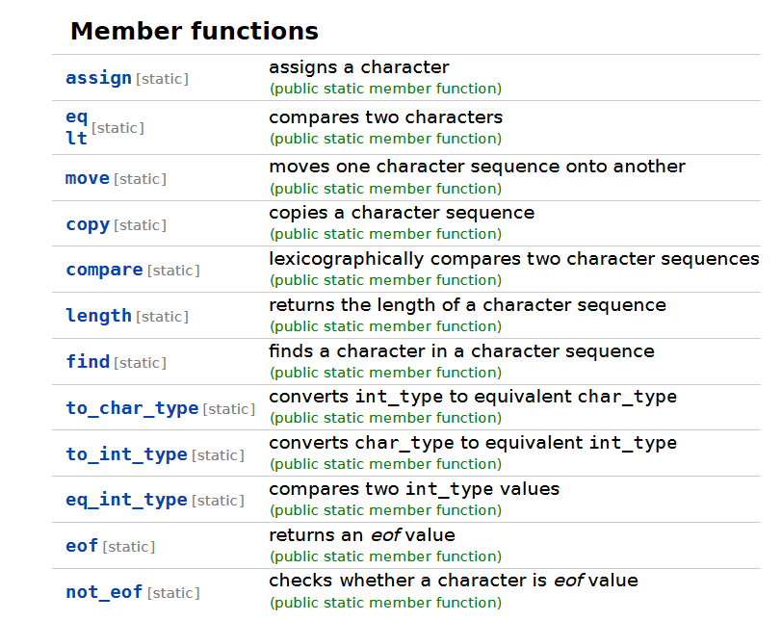
Traits: Bad Reputation
Interfaces for char_traits, allocators, and more from the standard
early designs using new features in the standard
not thoroughly vetted
imbued in things it had no business being in (IO and friends)

Slide 63
Traits: later iterations successful
std::map and std::unordered_map made better use of traits
Predicate and Hash follow guidelines of std::hash
Single-responsibility principle for Predicate and Hash
nlohmann::json is a templated type with sensible defaults
just change template parameter details if you do not like them!

Slide 64
Drawback: Traits
Change the template, change the type
cannot interoperate with sibling types by default (unless explicitly programmed in)
Brittle ABI
change default template parameters -> change name mangling
change template name -> any using/typedefs change name mangling
“Too much customizability”
Need to resist temptation to repeat mistake of std::char_traits

Slide 65
Traits: better for multithreaded environments
For when user has more control over the system and does not have to work in existing code
each class can have highly customized behavior specific to needs
avoids needing to share a single global universe of overload resolution / ADL space with others
great for application space
great for environments that are already type-rich / generic (C++)
Can deploy one trait class in one area, another in a separate area
will not crash the application space

Slide 66
ADL: better for stateless consistency
📞 ⚡
📞
“pick up and play” feeling
works from anywhere, obeys the same rules (however complicated)
better for the library developer space
sol3 picked ADL extension points for many reasons
user had to be able to be consistent across translation units
harder to have fixed ABI with trait-based state classes
sol::state / sol::state_view can interop with the scripting layer
better for handling type-deficient Lua and C coding environment (interop)

Slide 67

Struct Specialization: best for Precise Matching
Class SFINAE is some of the most expensive SFINAE one can perform
second only to non-concept function SFINAE in template arguments
SFINAE done on the return type of a function is faster
if constexpr is fastest
Template matching is very precise and does not do even basic conversions
less flexible than overload conversions
must define template for base class, first derived, second derived, etc. even if they are all do the same thing
Has no overload resolution issues (!!)

Slide 68
Future Talks?
Fully Runtime Extension Points for C++ Applications
Unassisted Runtime DLL Loading
LoadLibrary + GetProcAddress / dlopen + dlsym
Hooking
mhook / LD_PRELOAD
Hot Reloading
Debug Gap Placements to compile new code into
Visual C++ debug compilation
“Versioning” for the purposes of loading/calling code
ABI restrictions and friends

Slide 69





Thank YoU !
Eric Feselier, Titus Winters
Challenged me to research generic extension mechanisms for std::out_ptr (p1132)
Isabella Muerte
“Tell them an ADL customization point is insane” (she was right; overloading concerns were insane)
Lounge<C++>

Slide 70
Questions
❓

